Slide 1

Programming for problem solving
B.Tech I year – I Sem

Slide 2
Content
Structures:
  Defining structures,
  Initializing structures
  unions
  Array of structures
Arrays:
  one and two dimensional arrays
  Creating
  accessing and manipulating elements of arrays
Pointer:
  Introduction to pointer.
  Pointer to Array of Structure
  Pointer to Structure Within the same Structure : Self Referential

Slide 3
Structure
structure is another user defined data type available in C that allows to combine data items of different kinds.
Structures are used to represent a record. Suppose you want to keep track of your books in a library. You might want to track the following attributes about each book.
    Title
    Author
    Subject
    Book ID

Slide 4
Define Structure
To define a structure, you must use the struct statement. The struct statement defines a new data type, with more than one member.
Syntax: struct [structure tag]
        {
        member definition;
        member definition;
        ...
        member definition;
        } [one or more structure variables];

Slide 5
Initializing Structure
When we declare a structure, memory is not allocated for un-initialized variable.
Let us discuss very familiar example of structure student , we can initialize structure variable in different ways –
Way 1 : Declare and Initialize
struct student
{
char name[20];
int roll;
float marks;
} std1 = { "Pritesh",67,78.3 };
In the above code snippet, we have seen that structure is declared and as soon as after declaration we have initialized the structure variable.
std1 = { "Pritesh",67,78.3 }

Slide 6
Way 2 : Declaring and Initializing Multiple Variables
struct student
{
char name[20];
int roll;
float marks;
}
  std1 = {"Pritesh",67,78.3};
  std2 = {"Don",62,71.3};
In this example, we have declared two structure variables in above code. After declaration of variable we have initialized two variable.

Slide 7
Way 3 : Initializing Single member
struct student
{
int mark1;
int mark2;
int mark3;
} sub1={67};
Though there are three members of structure,only one is initialized , Then remaining two members are initialized with Zero. If there are variables of other data type then their initial values will be define in the above table.
Data Type | Default value if not initialized
integer | 0
float | 0.00
char | NULL

Slide 8
Way 4 : Initializing inside main
struct student
{
int mark1;
int mark2;
int mark3;
};
void main()
{
struct student s1 = {89,54,65};
- - - - -
- - - - - -
- - - - - --
};
When we declare a structure then memory won’t be allocated for the structure. i.e only writing below declaration statement will never allocate memory
We need to initialize structure variable to allocate some memory to the structure.
struct student s1 = {89,54,65};

Slide 9
Accessing Structure Members
To access any member of a structure, we use the member access operator (.). The member access operator is coded as a period between the structure variable name and the structure member that we wish to access.

Slide 10
#include <stdio.h>
#include <string.h>
struct Books
{
char title[50];
char author[50];
char subject[100];
int book_id;
};
int main( )
{
struct Books Book1; /* Declare Book1 of type Book */
struct Books Book2; /* Declare Book2 of type Book */
/* book 1 specification */
strcpy( Book1.title, "C Programming");
strcpy( Book1.author, "Nuha Ali");
strcpy( Book1.subject, "C Programming Tutorial");
Book1.book_id = 6495407;
/* book 2 specification */
strcpy( Book2.title, "Telecom Billing");
strcpy( Book2.author, "Zara Ali");
strcpy( Book2.subject, "Telecom Billing Tutorial");
Book2.book_id = 6495700;
/* print Book1 info */
printf( "Book 1 title : %s\n", Book1.title);
printf( "Book 1 author : %s\n", Book1.author);
printf( "Book 1 subject : %s\n", Book1.subject);
printf( "Book 1 book_id : %d\n", Book1.book_id);
/* print Book2 info */
printf( "Book 2 title : %s\n", Book2.title);
printf( "Book 2 author : %s\n", Book2.author);
printf( "Book 2 subject : %s\n", Book2.subject);
printf( "Book 2 book_id : %d\n", Book2.book_id);
return 0;
}

Slide 11
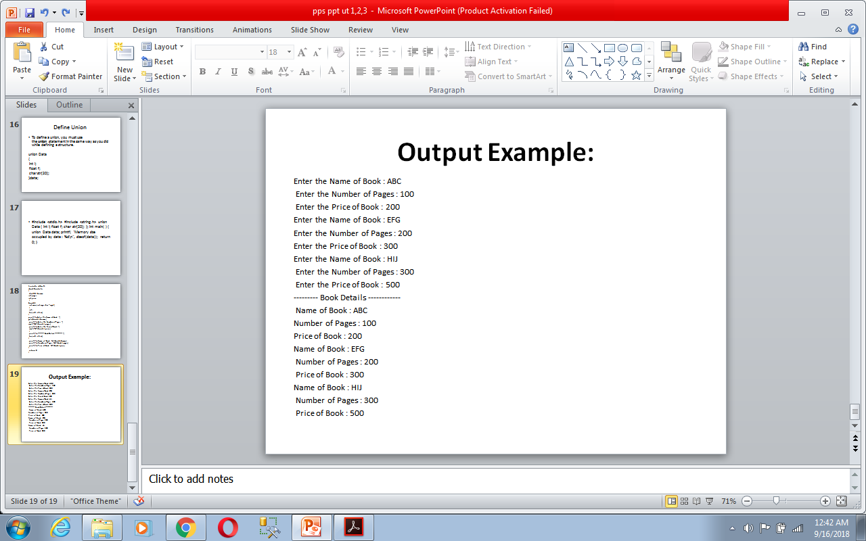
#include <stdio.h>
struct Bookinfo
{
char[20] bname;
int pages;
int price;
}
book[3];
int main(int argc, char *argv[])
{
int i;
for(i=0;i<3;i++)
{
printf("\nEnter the Name of Book : ");
gets(book[i].bname);
printf("\nEnter the Number of Pages : ");
scanf("%d",book[i].pages);
printf("\nEnter the Price of Book : ");
scanf("%f",book[i].price);
}
printf("\n--------- Book Details ------------ ");
for(i=0;i<3;i++)
{
printf("\nName of Book : %s",book[i].bname);
printf("\nNumber of Pages : %d",book[i].pages);
printf("\nPrice of Book : %f",book[i].price);
}
return 0;
}
Array of Structure

Slide 12
Arrays are of two types:
  One-dimensional arrays
  Multidimensional arrays
    Two dimensional arrays
    Three dimensional arrays
    Four dimentional arrays

Slide 13
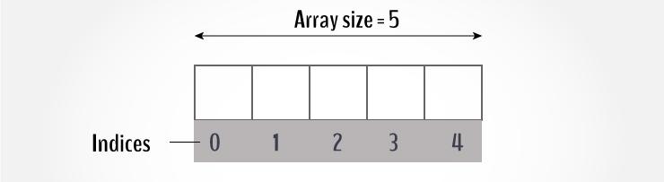
Arrays
An array is collection of similar elements.
Declaring Array in C
An array is a collection of data that holds fixed number of values of same type.
For example: if you want to store marks of 5 students, you can create an array for it.
Ex: int marks[5];
The size and type of arrays cannot be changed after its declaration.

Slide 14
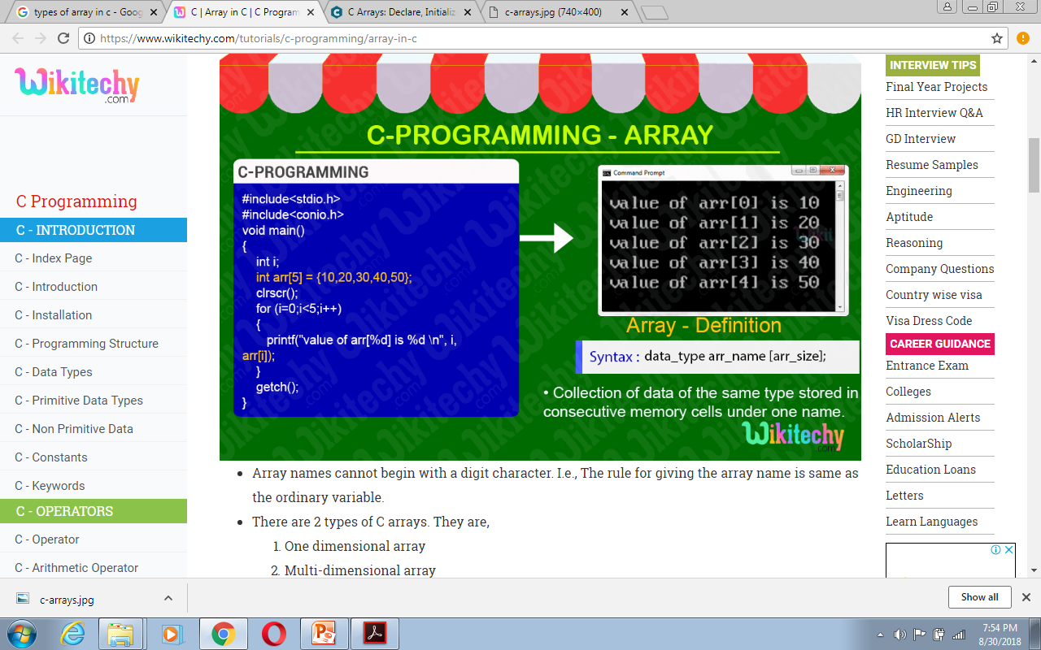
One dimensional array

Slide 15
Multi-dimensional Array
Multi-Dimensional Array:
  Two dimensional array. Ex:[][]
  Three dimensional array. Ex: [][][]
  N dimensional array. Ex: [1][][][][]…....[n]

Slide 16
Pointers
Pointers are powerful features of C and (C++) programming that differentiates it from other popular programming languages like: Java and Python.
Pointers are used in C program to access the memory and manipulate the address.

Slide 17
Pointers in C language is a variable that stores/points the address of another variable.
A Pointer in C is used to allocate memory dynamically i.e. at run time.
The pointer variable might be belonging to any of the data type such as int, float, char, double,short etc.
Pointer Syntax : data_type var_name;
Example : int *p; char *p;
Where, * is used to denote that “p” is pointer variable and not a normal variable.
& symbol is used to get the address of the variable.

Slide 18
Simple Pointer Example #1 :
#include<stdio.h>
int main()
{
int a = 3;
int *ptr;
ptr = &a;
return(0);
}

Slide 19
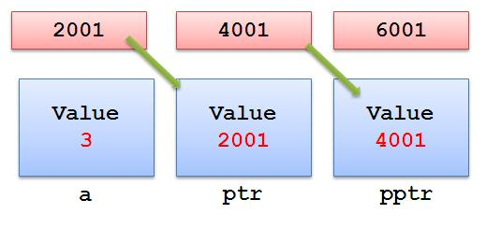
Internal Explanation

Slide 20
Simple Pointer Example #2 :
#include<stdio.h>
int main()
{
int a = 3;
int *ptr,**pptr;
ptr = &a;
pptr = &ptr;
return(0);
}

Slide 21
Internal Explanation

Slide 22
Pointers to Array and Structures:
Pointers to Array of structure
1. Pointer Variable can also Store the Address of the Structure Variable.
2. Pointer to Array of Structure stores the Base address of the Structure
array.
Suppose
struct Cricket
{
char team1[20];
char team2[20];
char ground[18];
int result;
}match[4] = {
{&quot;IND&quot;,&quot;AUS&quot;,&quot;PUNE&quot;,1},
{&quot;IND&quot;,&quot;PAK&quot;,&quot;NAGPUR&quot;,1},
{&quot;IND&quot;,&quot;NZ&quot;,&quot;MUMBAI&quot;,0},
{&quot;IND&quot;,&quot;SA&quot;,&quot;DELHI&quot;,1}
};

Slide 23
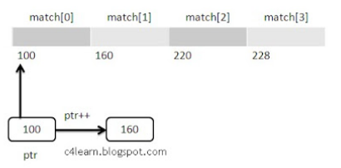
Pointer Is Declared and initialized as
struct Cricket *ptr = match
Here the address of match[0] is stored in pointer Variable ptr.

Slide 24
#include<stdio.h>
void main()
{
struct Cricket *ptr = match; // By default match[0]
for(i=0;i<4;i++)
{
printf(“\nMatch : %d”,i+1);
printf(“\n%s Vs %s”,ptr->team1,ptr->team2);
printf(“\nPlace : %s”,ptr->ground);
if(match[i].result == 1)
printf(“\nWinner : %s”,ptr->team1);
else
printf(“\nWinner : %s”,ptr->team1);
printf(“\n”);
// Move Pointer to next structure element
ptr++;
}
}
Output :
Match : 1
IND Vs AUS
Place : PUNE
Winner : IND
Match : 2
IND Vs PAK
Place : NAGPUR
Winner : IND
Match : 3
IND Vs NZ
Place : MUMBAI
Winner : NZ
Match : 4
IND Vs SA
Place : DELHI
Winner : IND

Slide 25
Pointer to Structure Within the same Structure : Self Referential
1. In this Type , Structure has pointer to itself.
2. Pointer stores the address of the Structure of same type.
Syntax :
struct node
{
int data;
struct node *ptr; //Pointer to Struct node
};
Here ptr stores address of Structure node.
This is useful in Dynamic Memory Allocation and Creating Linked Lists.

Slide 26
Self Referential structures
Self Referential structures are those structures that have one or more pointers which point to the same type of structure, as their member.
In other words, structures pointing to the same type of structures are self-referential in nature.
Example:
struct node
{
int data1;
char data2;
struct node* link;
};
int main()
{
struct node ob;
return 0;
}

Slide 27
In the above example ‘link’ is a pointer to a structure of type ‘node’. Hence, the structure ‘node’ is a self-referential structure with ‘link’ as the referencing pointer.
An important point to consider is that the pointer should be initialized properly before accessing, as by default it contains garbage value.
Types of Self Referential Structures
Self Referential Structure with Single Link
Self Referential Structure with Multiple Links

Slide 28
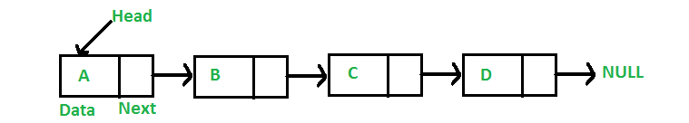
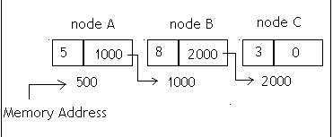
A linked list is a linear data structure, in which the elements are not stored at contiguous memory locations. The elements in a linked list are linked using pointers as shown in the below image:
In simple words, a linked list consists of nodes where each node contains a data field and a reference(link) to the next node in the list.

Slide 29
Enumeration (or enum) in C
Enumeration (or enum) is a user defined data type in C.
It is mainly used to assign names to integral constants, the names make a program easy to read and maintain.
enum State {Working = 1, Failed = 0};
The keyword ‘enum’ is used to declare new enumeration types in C
The name of enumeration is "flag" and the constant // are the values of the flag.
By default, the values// of the constants are as follows:// constant1 = 0, constant2 = 1,
constant3 = 2 and
// so on.enum flag{constant1, constant2, constant3, ....... };

Slide 30
Variables of type enum can also be defined.
They can be defined in two ways:
// In both of the below cases, "day" is
// defined as the variable of type week.
  enum week{Mon, Tue, Wed};
  enum week day;
  Or
// enum week{Mon, Tue, Wed}day;

Slide 31
// An example program to demonstrate working // of enum in C
#include<stdio.h>
enum week{Mon, Tue, Wed, Thur, Fri, Sat, Sun};
int main()
{
enum week day;
day = Wed;
printf("%d",day);
return 0;
}

Slide 32
UNIT III

Slide 33
Preprocessor:
The C Preprocessor is not a part of the compiler, but is a separate step in the compilation process.
In simple terms, a C Preprocessor is just a text substitution tool and it instructs the compiler to do required pre-processing before the actual compilation.
We'll refer to the C Preprocessor as CPP.

Slide 34
All preprocessor commands begin with a hash symbol (#).
It must be the first nonblank character, and for readability, a preprocessor directive should begin in the first column.

Slide 35
Commonly used preprocessor
Sr.No. | Directive & Description
1 | #define Substitutes a preprocessor macro.
2 | #include Inserts a particular header from another file.
3 | #undef Undefines a preprocessor macro.
4 | #ifdef Returns true if this macro is defined.
5 | #ifndef Returns true if this macro is not defined.
6 | #if Tests if a compile time condition is true.

Slide 36
FILES:
File is a collection of bytes that is stored on secondary storage devices like disk. There are two kinds of files in a system. They are,
  Text files (ASCII)
  Binary files

Slide 37
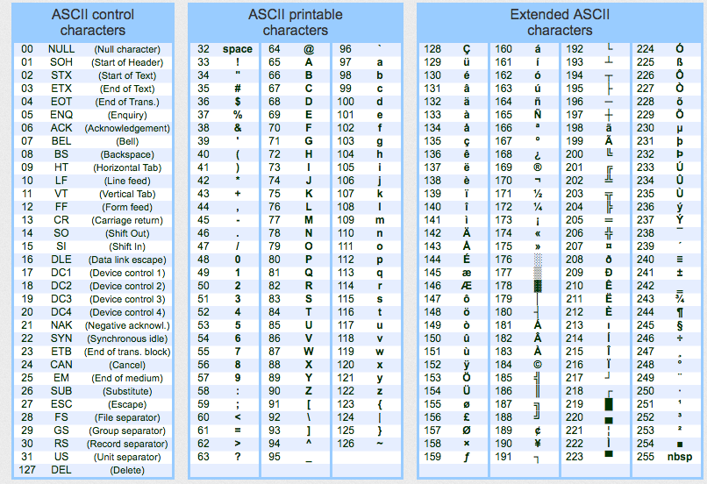
Text files contain ASCII [American standard code for information interchange]codes of digits, alphabetic and symbols.

Slide 38
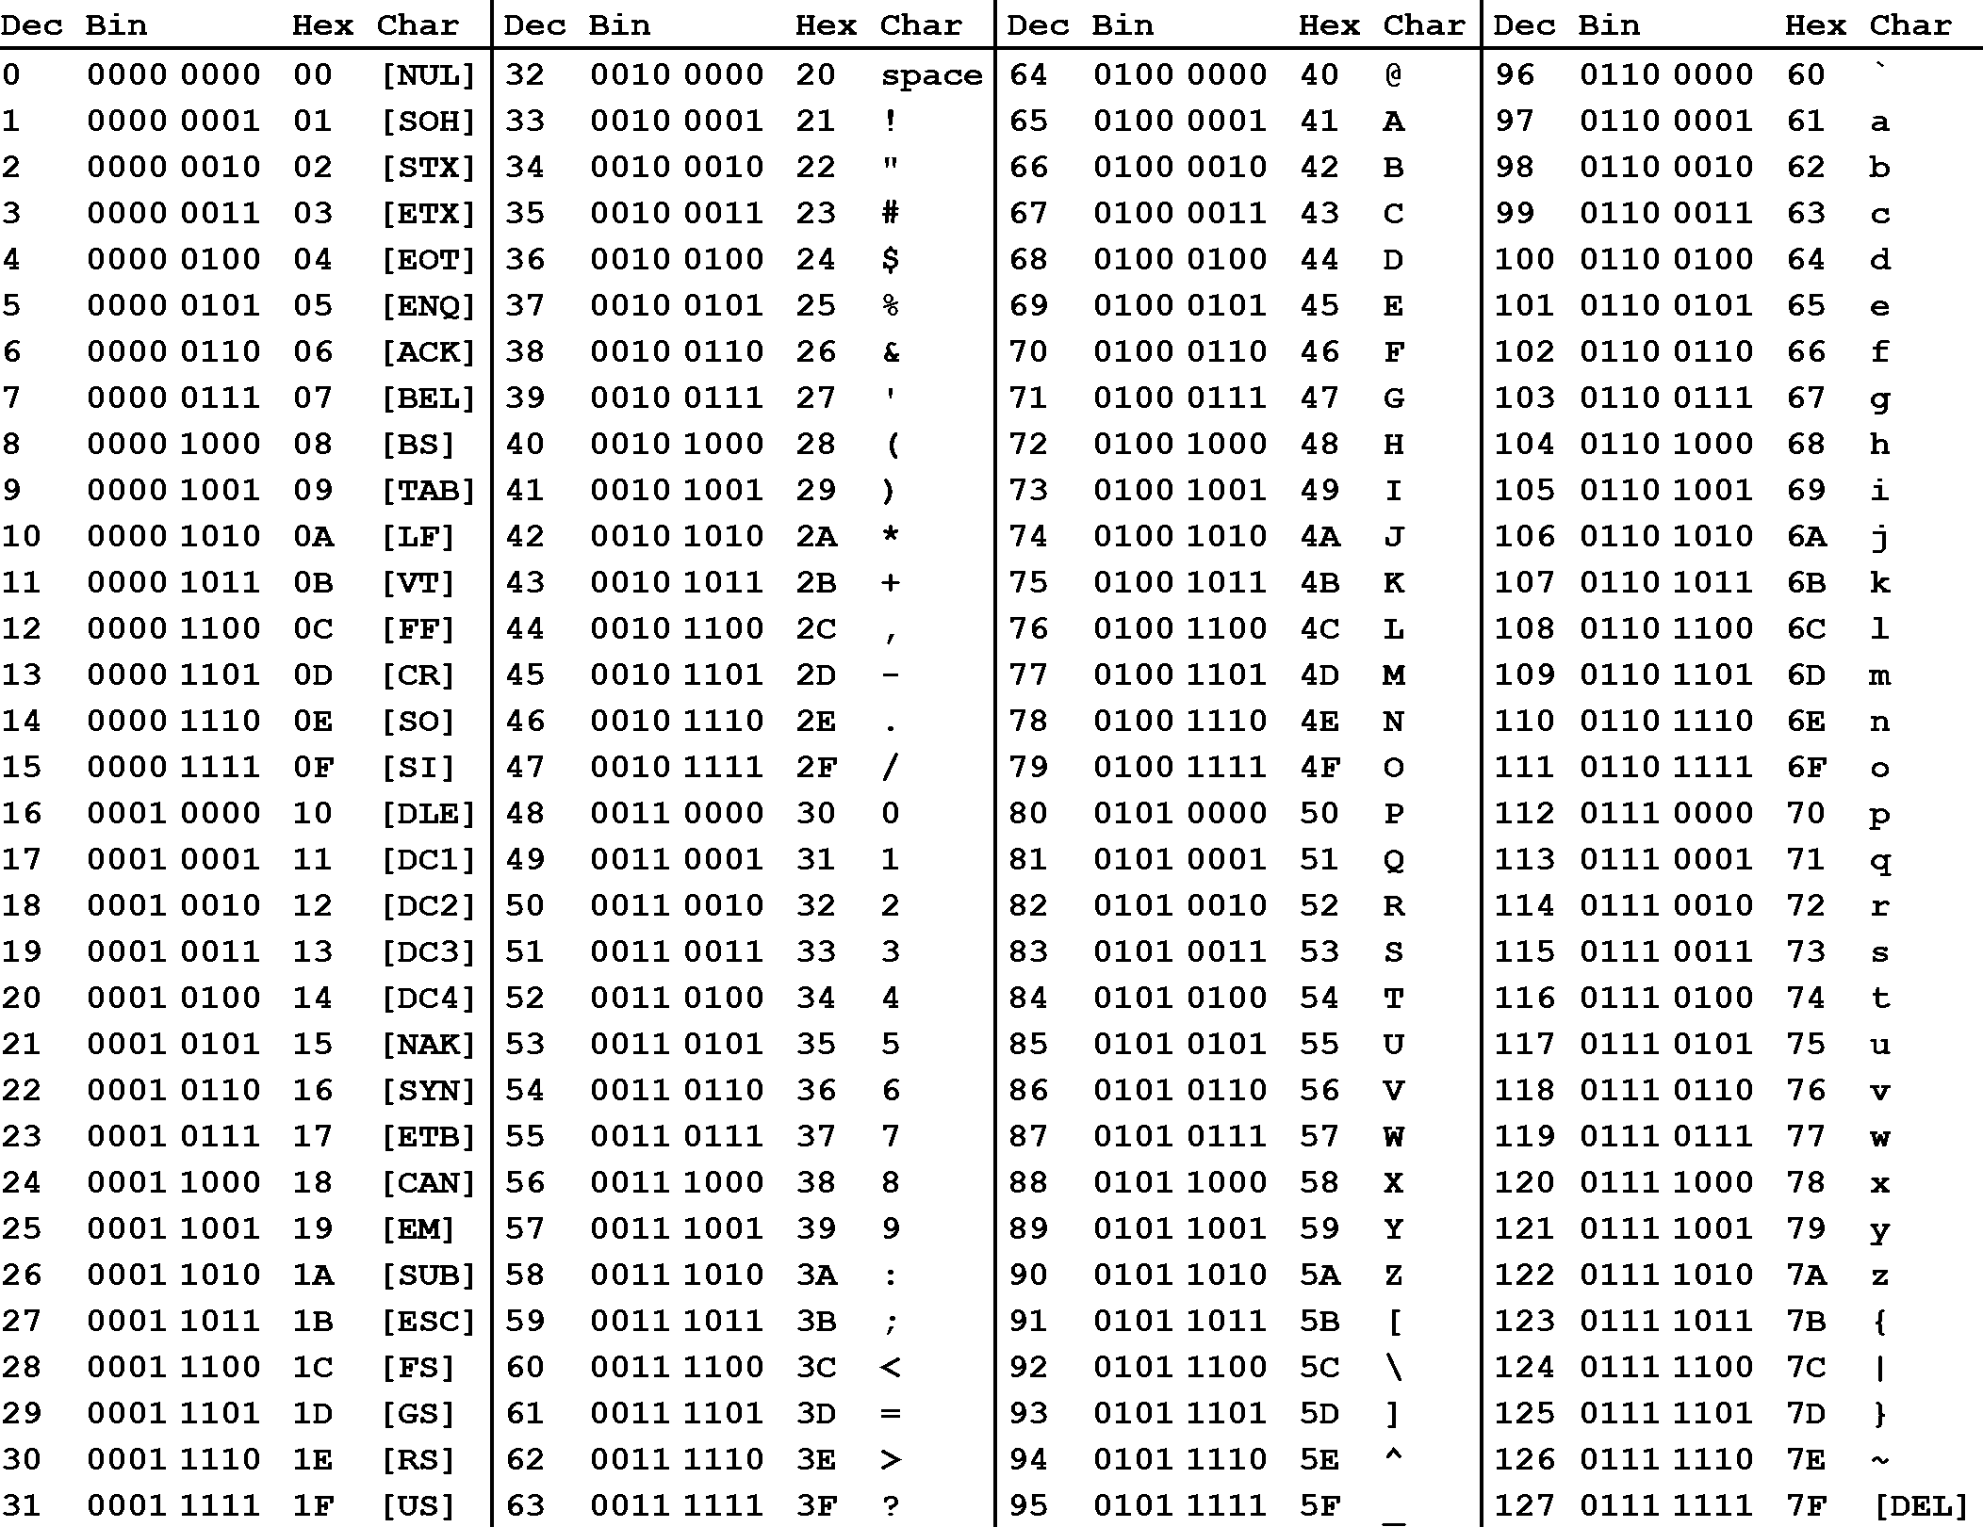
Binary file contains collection of bytes (0’s and 1’s). Binary files are compiled version of text files.

Slide 39
BASIC FILE OPERATIONS IN C PROGRAMMING:
There are 4 basic operations that can be performed on any files in C programming language. They are,
Opening/Creating a file
Closing a file
Reading a file
Writing in a file

Slide 40
File operation | Declaration & Description
fopen() – To open a file | Declaration: FILE *fopen (const char *filename, const char *mode) fopen() function is used to open a file to perform operations such as reading, writing etc. In a C program, we declare a file pointer and use fopen() as below. fopen() function creates a new file if the mentioned file name does not exist. FILE*fp; fp=fopen (“filename”, ”‘mode”); Where, fp – file pointer to the data type “FILE”. filename – the actual file name with full path of the file. mode – refers to the operation that will be performed on the file. Example: r, w, a, r+, w+ and a+. Please refer below the description for these mode of operations.
fclose() – To close a file | Declaration: int fclose(FILE *fp); fclose() function closes the file that is being pointed by file pointer fp. In a C program, we close a file as below. fclose (fp);

Slide 41
fgets() – To read a file | Declaration: char *fgets(char *string, int n, FILE *fp) fgets function is used to read a file line by line. In a C program, we use fgets function as below. fgets (buffer, size, fp); where, buffer – buffer to put the data in. size – size of the buffer fp – file pointer
fprintf() – To write into a file | Declaration: int fprintf(FILE *fp, const char *format, …); fprintf() function writes string into a file pointed by fp. In a C program, we write string into a file as below. fprintf (fp, “some data”); or fprintf (fp, “text %d”, variable_name);

Slide 42
MODE OF OPERATIONS PERFORMED ON A FILE IN C LANGUAGE:
There are many modes in opening a file. Based on the mode of file, it can be opened for reading or writing or appending the texts. They are listed below.
    r – Opens a file in read mode and sets pointer to the first character in the file. It returns null if file does not exist.
    w – Opens a file in write mode. It returns null if file could not be opened. If file exists, data are overwritten.
    a – Opens a file in append mode. It returns null if file couldn’t be opened.
    r+ – Opens a file for read and write mode and sets pointer to the first character in the file.
    w+ – opens a file for read and write mode and sets pointer to the first character in the file.
    a+ – Opens a file for read and write mode and sets pointer to the first character in the file. But, it can’t modify existing contents.

Slide 43
/ * Open, write and close a file : */
# include <stdio.h>
# include <string.h>
int main( )
{
FILE *fp ;
char data[50];
// opening an existing file
printf( "Opening the file test.c in write mode" ) ;
fp = fopen("test.c", "w") ;
if ( fp == NULL )
{
printf( "Could not open file test.c" ) ;
return 1;
}
printf( "\n Enter some text from keyboard” \
“ to write in the file test.c" ) ;
// getting input from user
while ( strlen ( gets( data ) ) > 0 )
{
// writing in the file
fputs(data, fp) ;
fputs("\n", fp) ;
}
// closing the file
printf("Closing the file test.c") ;
fclose(fp) ;
return 0;
}
Output:
Opening the file test.c in write mode
Enter some text from keyboard to write in the file test.c
Hai, How are you?
Closing the file test.c

Slide 44
INBUILT FUNCTIONS FOR FILE HANDLING IN C LANGUAGE:
C programming language offers many inbuilt functions for handling files.
File handling functions | Description
fopen () | fopen () function creates a new file or opens an existing file.
fclose () | fclose () function closes an opened file.
getw () | getw () function reads an integer from file.
putw () | putw () functions writes an integer to file.
fgetc () | fgetc () function reads a character from file.
fputc () | fputc () functions write a character to file.
gets () | gets () function reads line from keyboard.
puts () | puts () function writes line to o/p screen.
fgets () | fgets () function reads string from a file, one line at a time.
fputs () | fputs () function writes string to a file.
feof () | feof () function finds end of file.
fgetchar () | fgetchar () function reads a character from keyboard.
fprintf () | fprintf () function writes formatted data to a file.
fscanf () | fscanf () function reads formatted data from a file.

Slide 45
fputchar () | fputchar () function writes a character onto the output screen from keyboard input.
fseek () | fseek () function moves file pointer position to given location.
SEEK_SET | SEEK_SET moves file pointer position to the beginning of the file.
SEEK_CUR | SEEK_CUR moves file pointer position to given location.
SEEK_END | SEEK_END moves file pointer position to the end of file.
ftell () | ftell () function gives current position of file pointer.
rewind () | rewind () function moves file pointer position to the beginning of the file.
getc () | getc () function reads character from file.
getch () | getch () function reads character from keyboard.
getche () | getche () function reads character from keyboard and echoes to o/p screen.
getchar () | getchar () function reads character from keyboard.
putc () | putc () function writes a character to file.
putchar () | putchar () function writes a character to screen.
printf () | printf () function writes formatted data to screen.
sprinf () | sprinf () function writes formatted output to string.
scanf () | scanf () function reads formatted data from keyboard.
sscanf () | sscanf () function Reads formatted input from a string.
remove () | remove () function deletes a file.
fflush () | fflush () function flushes a file.

Slide 46
Random Access To File
There is no need to read each record sequentially, if we want to access a particular record.C supports these functions for random access file processing.
fseek()
ftell()
rewind()
fseek():
This function is used for seeking the pointer position in the file at the specified byte.
Syntax: fseek( file pointer, displacement, pointer position);

Slide 47
ftell()
This function returns the value of the current pointer position in the file.The value is count from the beginning of the file.
Syntax: ftell(fptr);
Where fptr is a file pointer.
rewind()
This function is used to move the file pointer to the beginning of the given file.
Syntax: rewind( fptr);
Where fptr is a file pointer.

